Slide 1
Integrated Analytics with Azure Synapse
Capstone Project

Slide 2
Introduction:
In this project I will be exploring data analytics workspace by using Azure Synapse Analytics, create ADLS Gen 2 accounts, Give admin-level access for Azure Synapse Analytics workspace.
Define the pipelines in Azure Synapse Analytics to transfer data from various data sources into the workspace for analysis.
Ingest the data in Azure synapse, Now analyze the data using the SQL pool and Apache Spark pool by adding the required Code Snippet.

Slide 3
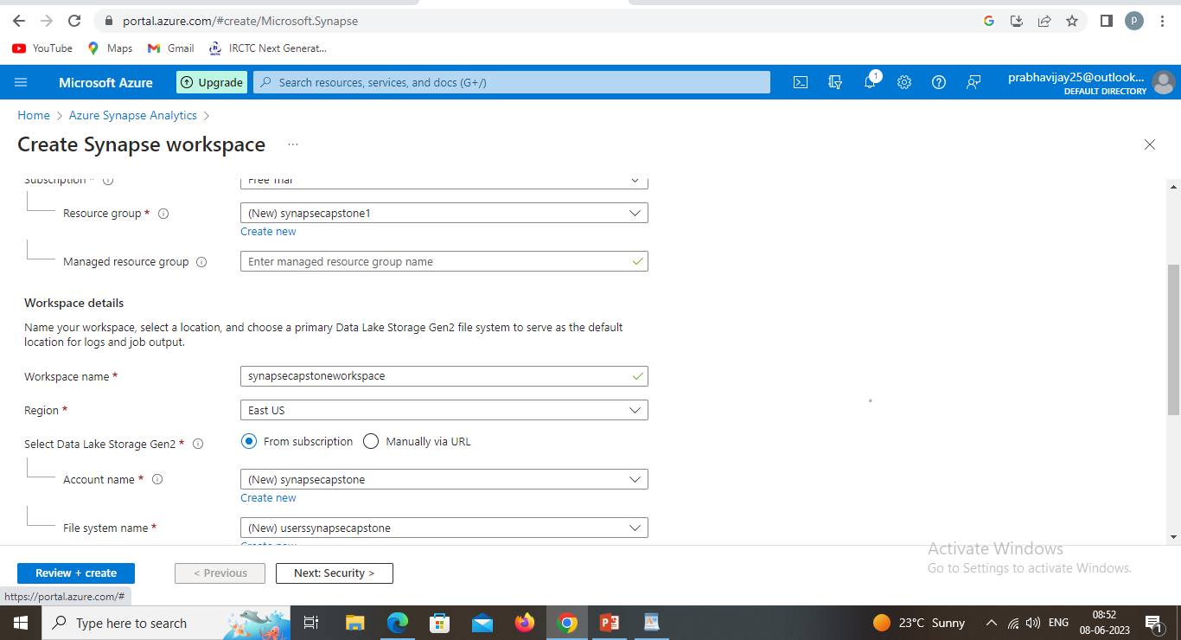
Problem Statement 1
In the project explore data analytics workspace by using azure synapse analytics ,create ADLS gen 2 accounts.

Slide 4
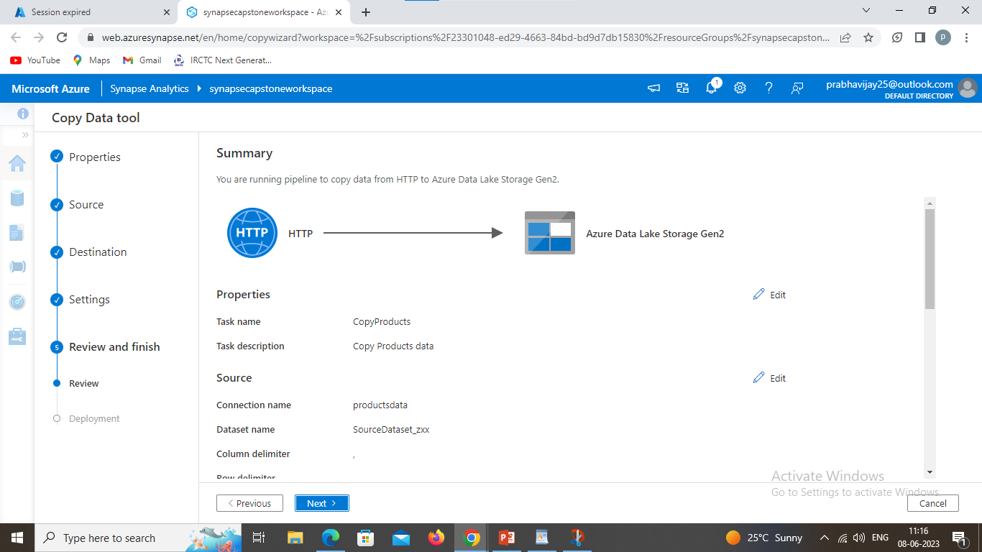
Ingest data with a pipeline:
One of the key tasks you can perform with Azure Synapse Analytics is to define pipelines that transfer (and if necessary, transform) data from a wide range of sources into your workspace for analysis.
In Synapse Studio, on the Home page, select Ingest to open the Copy Data tool
In the Copy Data tool, on the Properties step, ensure that Built-in copy task and Run once now are selected, and click Next >.

Slide 5
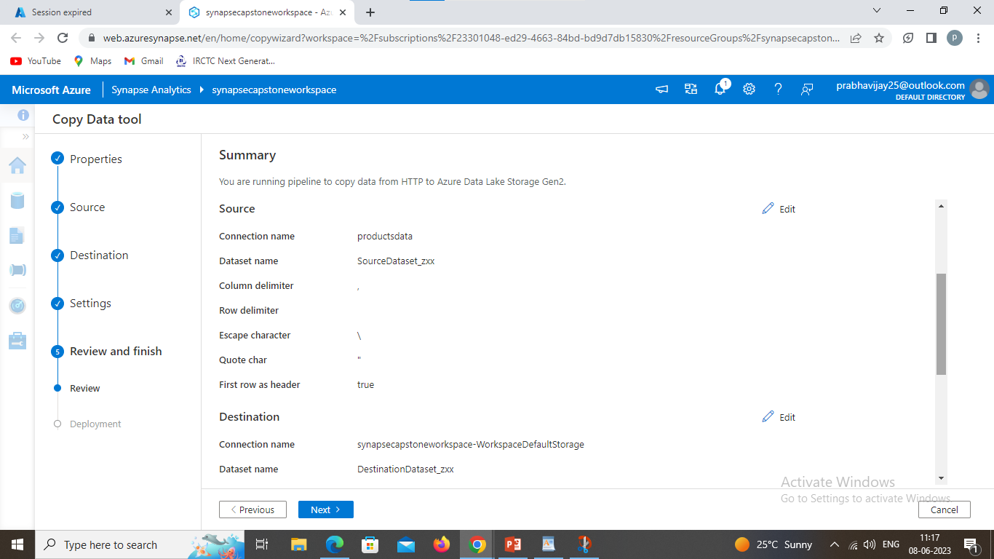
Create a new connection:
Name: products data.
Connect via integration runtime.
Source Dataset link for the workspace is
https://raw.githubusercontent.com/MicrosoftLearning/DP-900T00A-Azure-Data-Fundamentals/master/Azure-Synapse/products.csv
Enable Server certificate Validation.
Anonymous Authentication type.
Destination Type will be ADLS Gen 2 and select the existing storage account that you have created on the Azure portal.

Slide 6
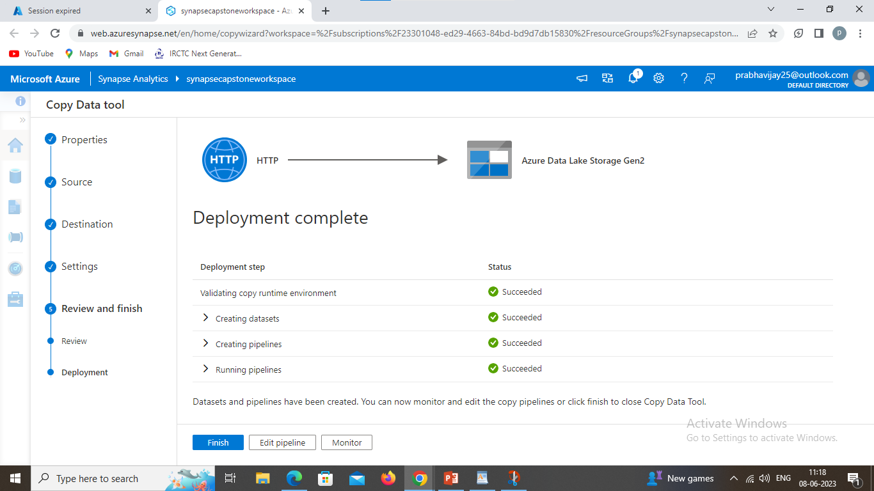
Pipeline creation and Deployment:
You can define the pipelines in Azure Synapse Analytics to transfer data from various data sources into the workspace for analysis.

Slide 7
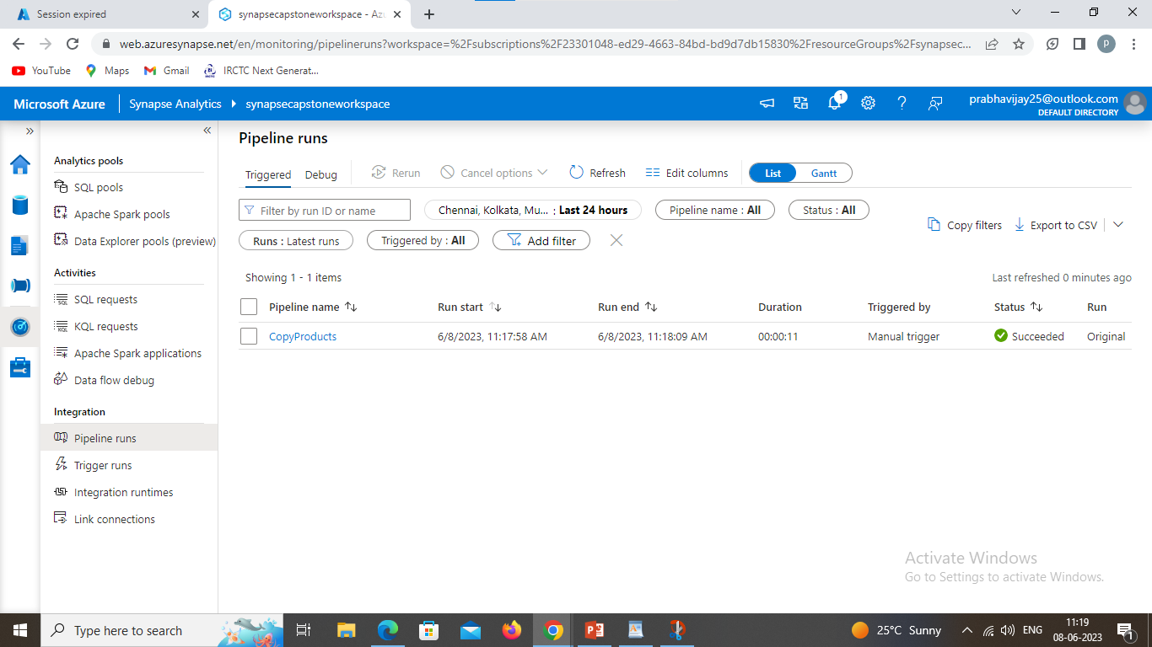
Pipeline Run:
Run the pipeline

Slide 8
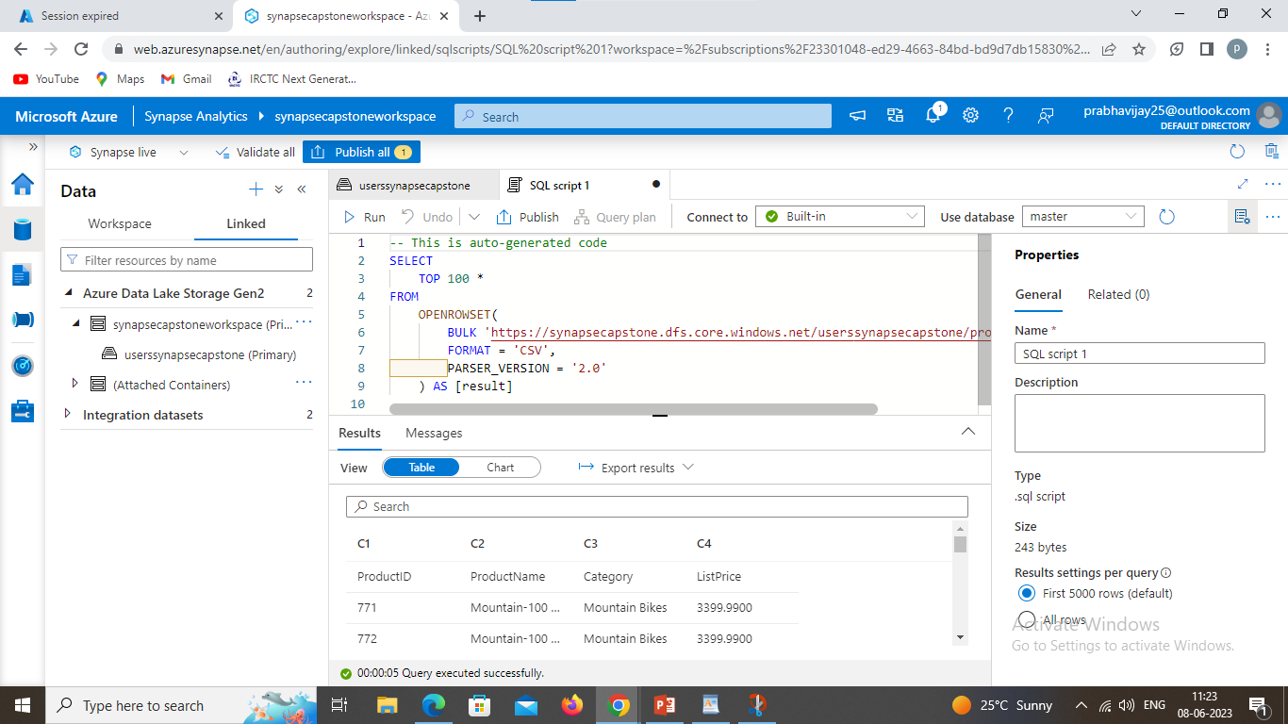
Problem Statement 2
Explore Data hub, click on linked to expand the ADLS Gen2, find your file name on the page you will find products.csv files.
Analyze and query the data that has been ingested in the Azure Synapse workspace where we can run SQL code.
You need to find the TOP 100 rows from New SQL Script from your data in the workspace, once you see an auto-generated code before running the code make sure the connect to is selected as built-in and use database as master, run the code and check the result datasets.

Slide 9
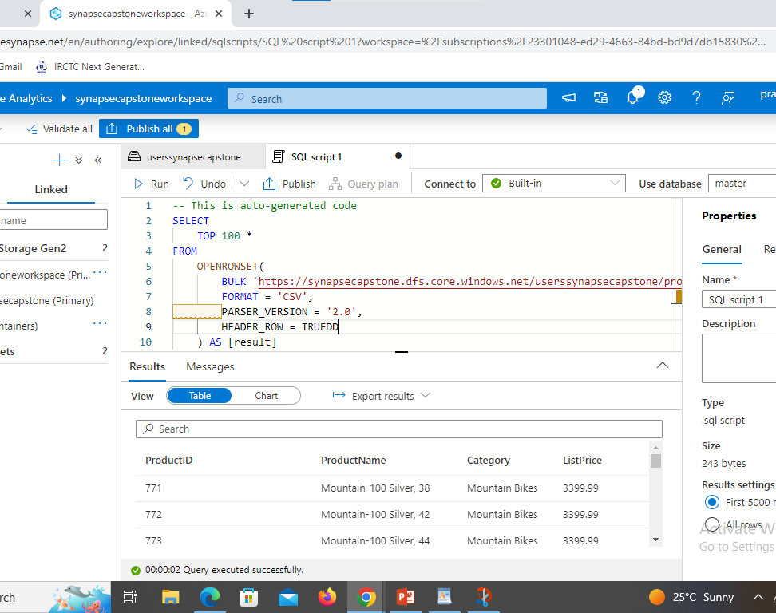
Data analysis:
There will be an issue with the result it shows the column name as c1, c2, c3 and c4 to fix this in the code add HEADER_ROW = TRUE before AS [result] run the code again and check the result dataset.

Slide 10
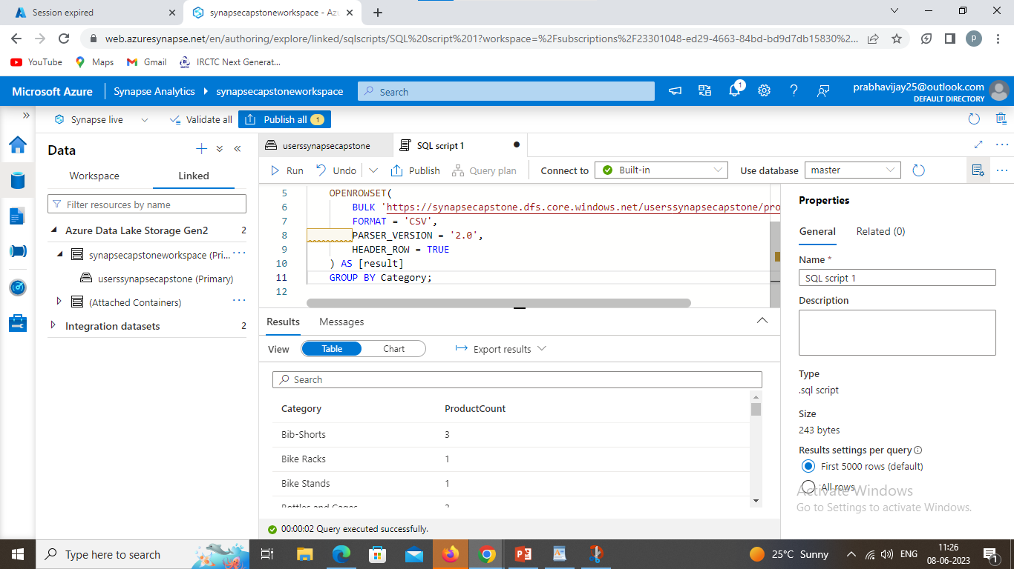
Data analysis:
Now you need the update the query by selecting the category and count as Product Numbers .
Once the updating is done select the properties of SQL Script 1 and update the name by Count Products by category and check SQL Script 1 will be updated and published the saved code.

Slide 11
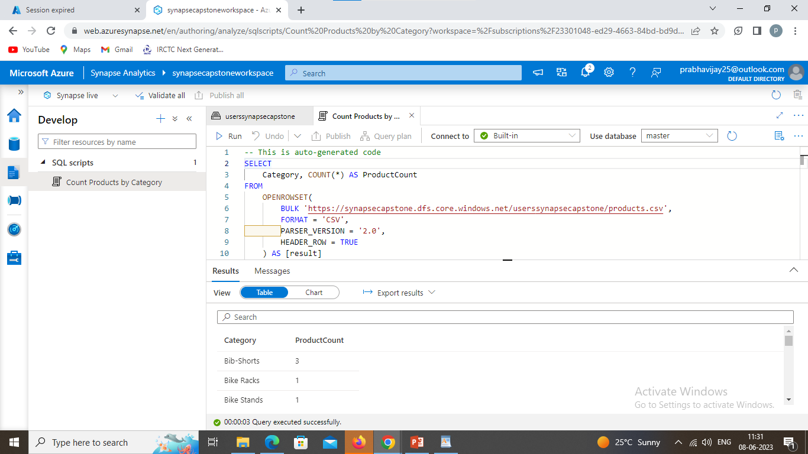
Data analysis:
Choose the Develop hub from the workspace and there you will find the published code reopen it and make it is Built-in SQL pool and run again to access the number of total products.

Slide 12
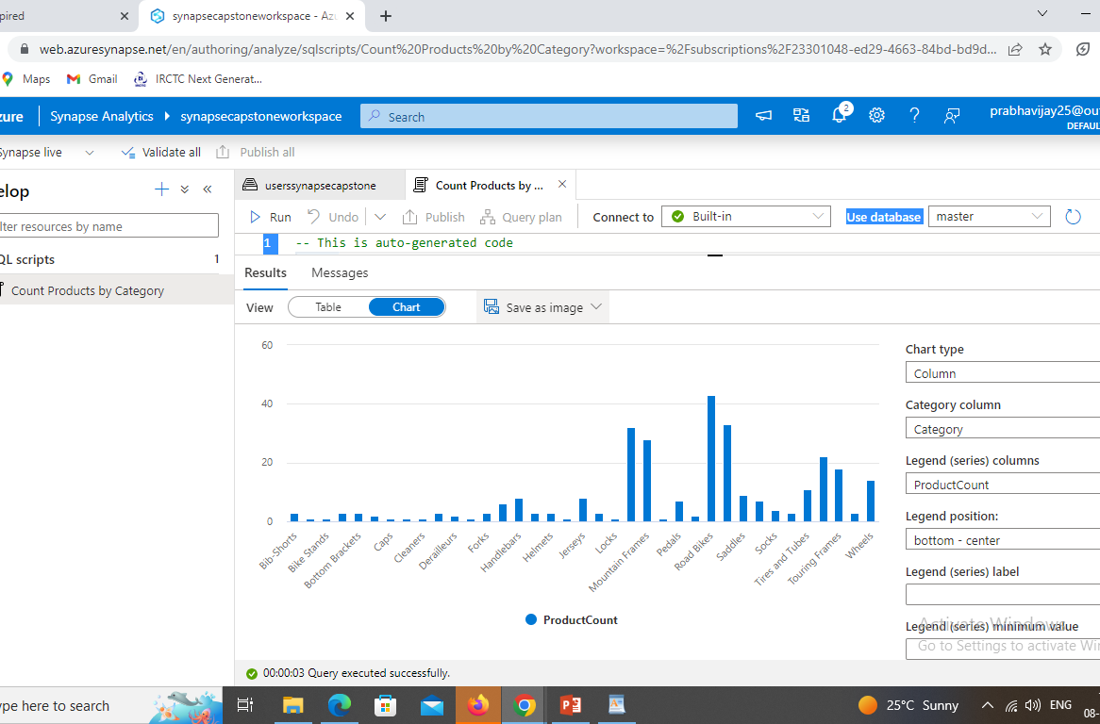
Data Visualization:
Go the result set and select chart view make necessary changes to it:
Chart type- Column
Category Column- Category
Legend (series) columns- Number of products
Legend position- bottom-center

Slide 13
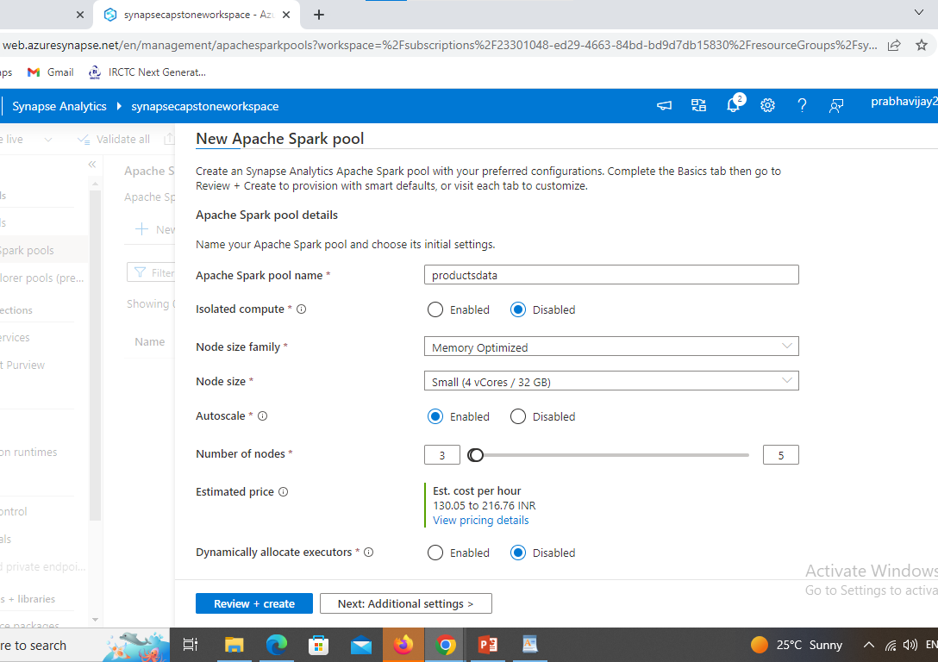
Problem Statement 3
Move to Manage hub and select Apache Spark pool click +New to create a new Spark pool with the inputs such as:
Apache Spark pool name- any name of your choice
Node Size Family- as default
Node Size- Default
Autoscale- Enabled
Number of nodes- 3—5
On the synapse workspace right click on products.csv and select new notebook and choose Load to dataFrame, language is set as PySpark (Python).

Slide 14
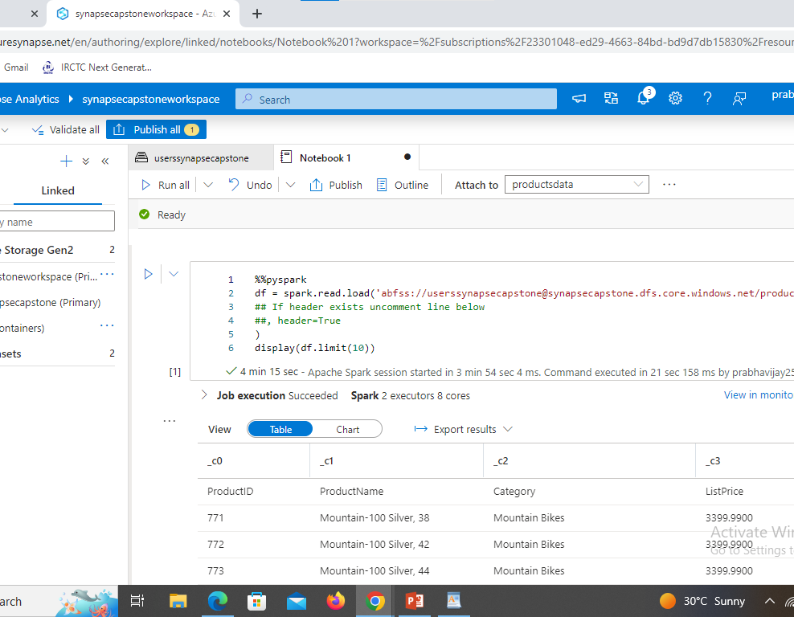
Analyze the data using the spark pool:
Now analyze the data using the Spark pool as we all know SQL is common query language for structured datasets and there are languages like python which is effectively used for data analysis.
On the synapse workspace right click on products.csv and select new notebook and choose Load to dataFrame, language is set as PySpark (Python).
Note: At First Spark tool will take some time to start and second will take less time to execute and the pool is already ready.

Slide 15
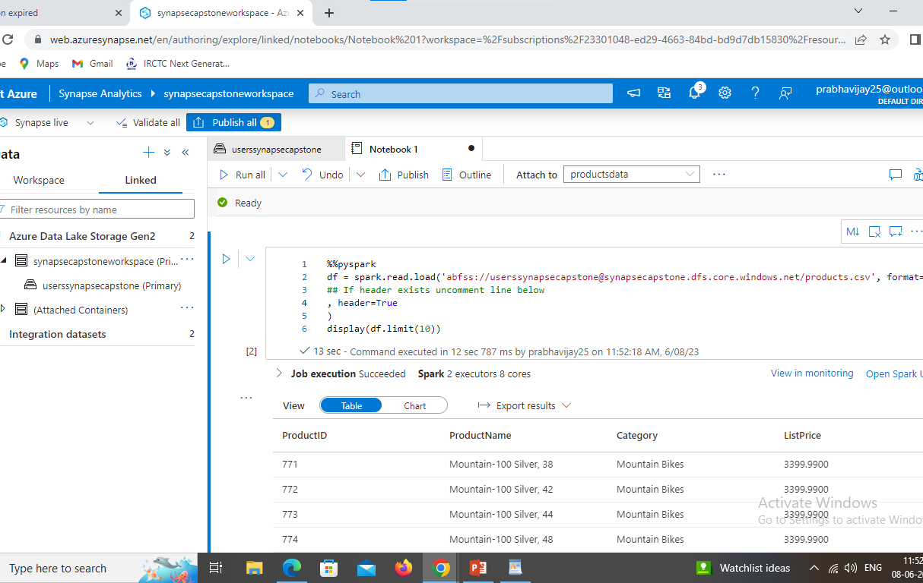
Analyze the data using the spark pool:
Run the code and check the dataset that looks similar as the previous operations in SQL pool, however it’s the python syntax that uses spark pool to execute the code.

Slide 16
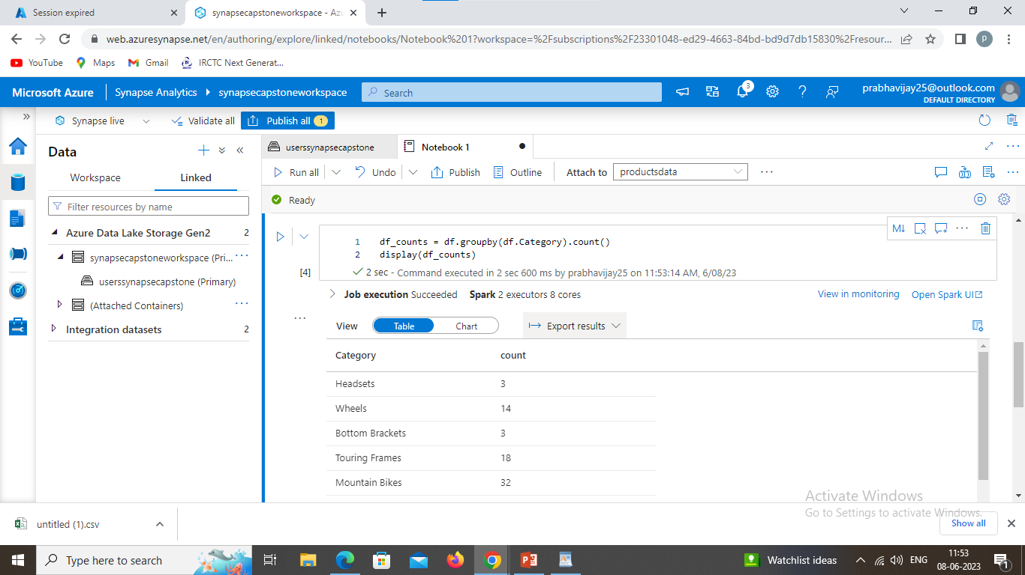
Analyze the data using the spark pool:
Now you need the update the data frame by selecting the category and count.

Slide 17
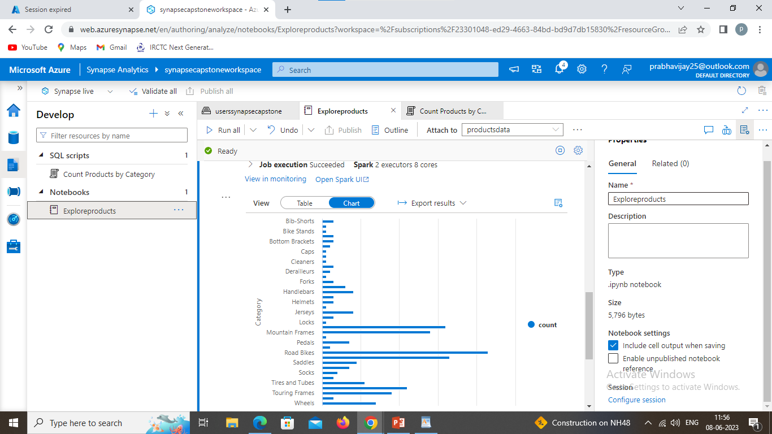
Data Visualization:
In the results output for the cell, select the Chart view. The resulting chart should resemble this:

